Slide 1
HEADING FOR PRESENTATION HERE
DATE OR SUBHEADING HERE

Slide 2
Generative Adversarial Network
GAN was first introduced by Ian Goodfellow et al in 2014
Have been used in generating images, videos, poems, some simple conversation.
Note, image processing is easy (all animals can do it), NLP is hard (only human can do it).
This co-evolution approach might have far-reaching implications. Bengio: this may hold the key to making computers a lot more intelligent.
Ian Goodfellow:
https://www.youtube.com/watch?v=YpdP_0-IEOw
Radford, (generate voices also here)
https://www.youtube.com/watch?v=KeJINHjyzOU
Tips for training GAN: https://github.com/soumith/ganhacks

Slide 3
Maximum Likelihood Estimation
Give a data distribution P_{data}(x)
We use a distribution P_{G}(x;θ) parameterized by θ to approximate it
E.g. P_{G}(x;θ) is a Gaussian Mixture Model, where θ contains means and variances of the Gaussians.
We wish to find θ s.t. P_{G}(x;θ) is close to P_{data}(x)
In order to do this, we can sample
{x¹,x², … x^{m}} from P_{data}(x)
The likelihood of generating these
x^{i}’s under P_{G} is
L= Π_{i=1…m} P_{G}(x^{i}; θ)
Then we can find θ* maximizing the L.

Slide 4
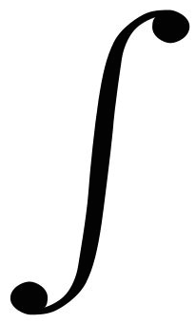
KL (Kullback-Leibler) divergence
Discrete:
D_{KL}(P||Q) = Σ_{i}P(i)log[P(i)/Q(i)]
Continuous:
D_{KL}(P||Q) = p(x)log [p(x)/q(x)]
Explanations:
Entropy: - Σ_{i}P(i)logP(i) - expected code length (also optimal)
Cross Entropy: - Σ_{i}P(i)log Q(i) – expected coding
length using optimal code for Q
D_{KL}= Σ_{i}P(i)log[P(i)/Q(i)] = Σ_{i}P(i)[logP(i) – logQ(i)], extra bits
JSD(P||Q) = ½ D_{KL}(P||M)+ ½ D_{KL}(Q||M), M= ½ (P+Q), symmetric KL
* JSD = Jensen-Shannon Divergency
∞
−∞

Slide 5
Maximum Likelihood Estimation
θ* = arg max_{θ} Π_{i=1..m}P_{G}(x^{i}; θ) →
arg max_{θ} log Π_{i=1..m}P_{G}(x^{i}; θ)
= arg max_{θ} Σ_{i=1..m} log P_{G}(x^{i}; θ), {x¹,..., x^{m}} sampled from P_{data}(x)
= arg max_{θ} Σ_{i=1..m} P_{data}(x^{i}) log P_{G}(x^{i}; θ) --- this is cross entropy
≅ arg max_{θ} Σ_{i=1..m} P_{data}(x^{i}) log P_{G}(x^{i}; θ) - Σ_{i=1..m} P_{data}(x^{i} )logP_{data}(x ^{i})
= arg min_{θ} KL (P_{data}(x) || P_{G}(x; θ)) --- this is KL divergence
Note: P_{G} is Gaussian mixture model, finding best θ will still be Gaussians, this only can generate a few blubs. Thus this above maximum likelihood approach does not work well.
Next we will introduce GAN that will change P_{G}, not just estimating P_{G is} parameters We will find best P_{G} , which is more complicated and structured, to approximate P_{data}.

Slide 6

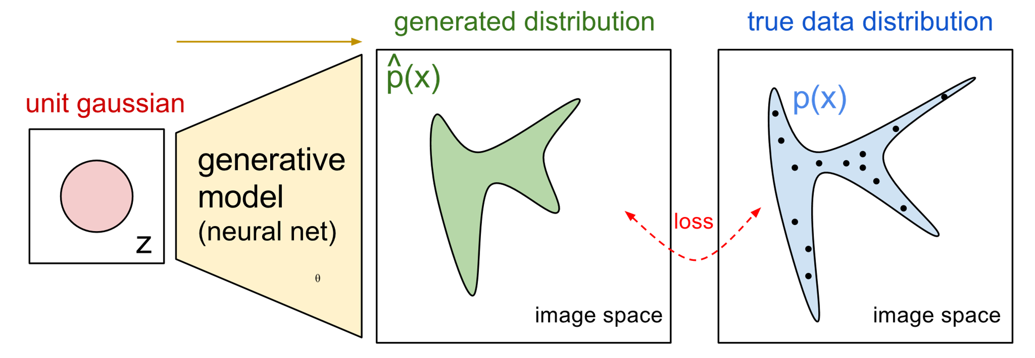

Thus let’s use an NN as P_{G}(x; θ)
P_{G}(x,θ)
P_{data}(x)
G
θ
Prior
distribution
of z
Smaller
dimension
Larger
dimension
How to compute the likelihood?
P_{G}(x) = Integration_{z} P_{prior}(z) I_{[G(z)=x]}dz
https://blog.openai.com/generative-models/

Slide 7
Basic Idea of GAN
Generator G
G is a function, input z, output x
Given a prior distribution P_{prior}(z), a probability distribution P_{G}(x) is defined by function G
Discriminator D
D is a function, input x, output scalar
Evaluate the “difference” between P_{G}(x) and P_{data}(x)
In order for D to find difference between P_{data} from P_{G}, we need a cost function V(G,D):
G*=arg min_{G}max_{D}V(G,D)
Note, we are changing distribution G, not just update
its parameters (as in the max likelihood case).
Hard to learn P_{G} by maximum likelihood

Slide 8


Basic Idea
G* = arg min_{G}max_{D} V(G,D)
Pick JSD function: V = E_{x~P_data} [log D(x)] + E_{x~P_G}[log(1-D(x))]
Given a generator G, max_{D}V(G,D) evaluates the
“difference” between P_{G} and P_{data}
Pick the G s.t. P_{G} is most similar to P_{data}
V(G₁,D)
V(G₂,D)
V(G₃,D)
G₁
G₂
G₃

Slide 9
Max_{D}V(G,D), G*=arg min_{G}max_{D}V(G,D)
Given G, what is the optimal D* maximizing
Given x, the optimal D* maximizing is:
f(D) = alogD + blog(1-D) ➔ D*=a/(a+b)
V = E_{x~P_data} [log D(x)] + E_{x~P_G}[log(1-D(x))]
= Σ [ P_{data}(x) log D(x) + P_{G}(x) log(1-D(x) ]
Thus: D*(x) = P_{data}(x) / (P_{data}(x)+P_{G}(x))
Assuming D(x) can have any value here

Slide 10


max_{D}V(G,D), G* = arg min_{G}max_{D} V(G,D)
D₁*(x) = P_{data}(x) / (P_{data}(x)+P_{G_1}(x))
D₂*(x) = P_{data}(x) / (P_{data}(x)+P_{G_2}(x))
“difference” between P_{G1} and P_{data}
V(G₁,D*₁)
V(G₁,D)
V(G₂,D)
V(G₃,D)

Slide 11
max_{D}V(G,D)
V = E_{x~P_data} [log D(x)]
+ E_{x~P_G}[log(1-D(x))]
max_{D} V(G,D)
= V(G,D*), where D*(x) = P_{data} / (P_{data} + P_{G}), and
1-D*(x) = P_{G} / (P_{data} + P_{G})
= E_{x~P_data} log D*(x) + E_{x~P_G} log (1-D*(x))
≈ Σ [ P_{data} (x) log D*(x) + P_{G}(x) log (1-D*(x)) ]
= -2log2 + 2 JSD(P_{data} || P_{G} ),
JSD(P||Q) = Jensen-Shannon divergence
= ½ D_{KL}(P||M)+ ½ D_{KL}(Q||M)
where M= ½ (P+Q).
D_{KL}(P||Q) = Σ P(x) log P(x) /Q(x)
Notes:
Converge

Slide 12
Summary:
V = E_{x~P_data} [log D(x)]
+ E_{x~P_G}[log(1-D(x))]
Generator G, Discriminator D
Looking for G* such that
Given G, max_{D} V(G,D)
= -2log2 + 2JSD(P_{data}(x) || P_{G}(x))
What is the optimal G? It is G that makes JSD smallest = 0:
P_{G}(x) = P_{data} (x)
G* = arg min_{G}max_{D} V(G,D)

Slide 13

Algorithm
G* = arg min_{G}max_{D} V(G,D)
L(G), this is the
loss function
To find the best G minimizing the loss function L(G):
θ_{G} ← θ_{G} =−η L(G)/ θ_{G ,} θ_{G} defines G
Solved by gradient descent. Having max ok. Consider simple case:
f(x) = max {D₁(x), D₂（x), D₃(x)}
If D_{i}(x) is the
Max in that region,
then do dD_{i}(x)/dx
D₁(x)
D₃(x)
D₂(x)
dD₁(x)/dx
dD₂(x)/dx
dD₃(x)/dx

Slide 14
Algorithm
G* = arg min_{G}max_{D} V(G,D)
L(G)
Given G₀
Find D*₀ maximizing V(G₀,D)
V(G₀,D₀*) is the JS divergence between P_{data}(x) and P_{G0}(x)
θ_{G} ← θ_{G} −η ΔV(G,D₀*) / θ_{G} ➔ Obtaining G₁ (decrease JSD)
Find D₁* maximizing V(G₁,D)
V(G₁,D₁*) is the JS divergence between P_{data}(x) and P_{G1}(x)
θ_{G} ← θ_{G} −η ΔV(G,D₁*) / θ_{G} ➔ Obtaining G₂ (decrease JSD)
And so on …

Slide 15
In practice …
V = E_{x~P_data} [log D(x)]
+ E_{x~P_G}[log(1-D(x))]
Given G, how to compute max_{D}V(G,D)?
Sample {x¹, … ,x^{m}} from P_{data}
Sample {x*¹, … ,x*^{m}} from generator P_{G}
Maximize:
V’ = 1/m Σ_{i=1..m} logD(x^{i}) + 1/m Σ_{i=1..m} log(1-D(x*^{i}))
Positive example
D must accept
Negative example
D must reject
This is what a Binary Classifier do
Output is D(x)
Minimize Cross-entropy
If x is a positive example
Minimize –log D(x)
If x is a negative example
Minimize –log(1-D(x))

Slide 16
Binary Classifier
Output is f(x)
Minimize Cross-entropy
If x is a positive example
Minimize –log f(x)
If x is a negative example
Minimize –log(1-f(x))
D is a binary classifier (can be deep) with parameters θ_{d}
{x¹,x², … x^{m}} from P_{data} (x)
Positive examples
{x*¹,x*², … x*^{m}} from P_{G}(x)
Negative examples
Minimize
L = - V’
or
Maximize
V’ = Σ_{i=1..m} logD(x^{i}) + 1/m Σ_{i=1..m} log(1-D(x*^{i}))

Slide 17
Algorithm
Initialize θ_{d} for D and θ_{g} for G
Can only find lower bound of JSD or max_{D}V(G,D)
In each training iteration
Sample m examples {x¹,x², … x^{m}} from data distribution P_{data}(x)
Sample m noise samples {z¹, … , z^{m}} from a simple prior P_{prior}(z)
Obtain generated data {x*¹, … , x*^{m}}, x*^{i}=G(z^{i})
Update discriminator parameters θ_{d} to maximize
V’ ≈ 1/m Σ_{i=1..m} logD(x^{i}) + 1/m Σ_{i=1..m} log(1-D(x*^{i}))
θ_{d} ← θ_{d} + ηΔV’(θ_{d}) (gradient ascent)
Simple another m noise samples {z¹,z², … z^{m}} from the prior P_{prior}(z)，G(z^{i})=x*^{i}
Update generator parameters θ_{g} to minimize
V’= 1/mΣ_{i=1..m} logD(x^{i}) + 1/m Σ_{i=1..m} log(1-D(x*^{i}))
θ_{g} ← θ_{g} − ηΔV’(θ_{g}) (gradient descent)
Ian Goodfellow
comment: this
is also done once
Learning D
Repeat k times
Learning G
Only Once
Notes:
位什麼要 1- 啊

